Slide 1
TinyML Assignment 2
Weed detection in soybean crops using custom lightweight deep learning models
By Najmeh Razfar, Julian True, Rodina Bassiouny, Vishaal Venkatesh, Rasha Kashef

Slide 2
Weed detection in soybean crops using custom lightweight deep learning models
By Najmeh Razfar, Julian True, Rodina Bassiouny, Vishaal Venkatesh, Rasha Kashef
Published in 2022
Journal of Agriculture and Food Research

Slide 3
Objective: Reproduce and evaluate weed detection models
Models implemented:
Custom CNNs (3 variants)
Transfer Learning: MobileNetv2, ResNet50
Training platform: Google Colab
Deployment platform: Raspberry Pi 4 (4GB RAM)
Metrics :Accuracy, Latency, Memory usage

Slide 4
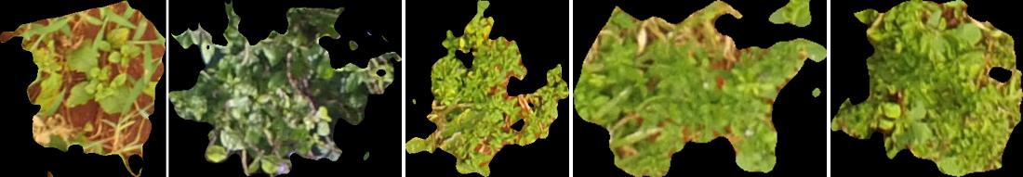
Dataset
4 Classes : Soybean, Soil, Broadleaf weeds and Grass
Public Dataset – on Mendeley → Weed Detection in Soybean Crops Using ConvNets (2017)
400 images -> 15336 segments

Slide 5
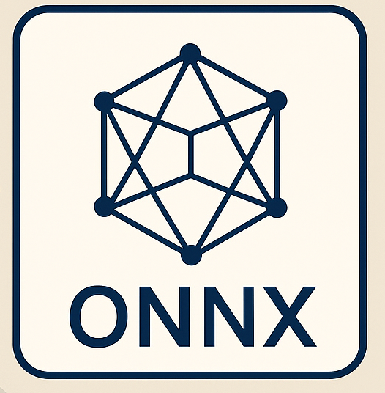
Implementation & Deployment
ONNX Conversion:
PyTorch models exported to ONNX format
Enabled cross-platform inference
Dynamic INT8 quantization applied
Execution:
Models loaded using ONNX Runtime
Inference performed on CPU
Metrics measured:
Accuracy
Latency (per image)
Memory usage (psutil)

Slide 6
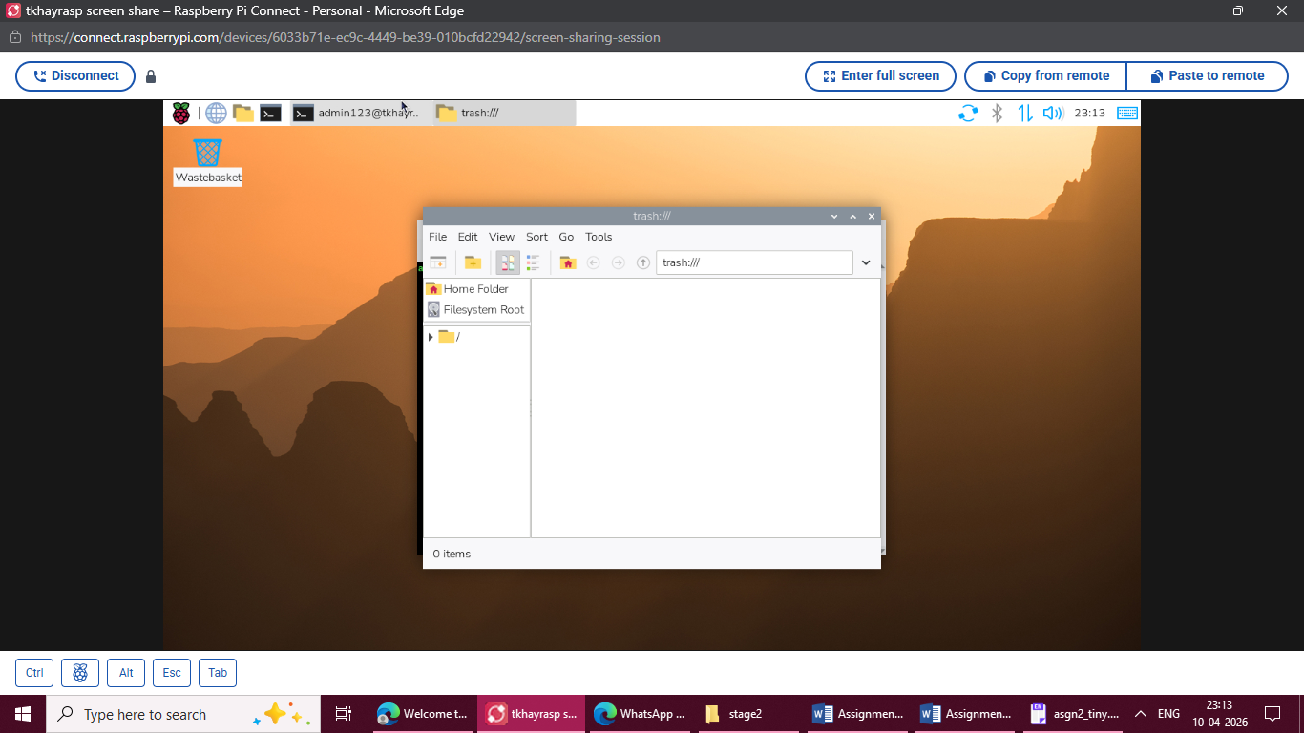
Raspberry Pi Access
Connection Methods: Screen sharing via Raspberry Pi Connect
Need stable Internet Connection
Not that reliable
Ethernet setup with DHCP (192.168.1.1)
Remote Access:
SSH using hostname: tkhayrasp
CLI used for:
Running scripts & Monitoring performance

Slide 7
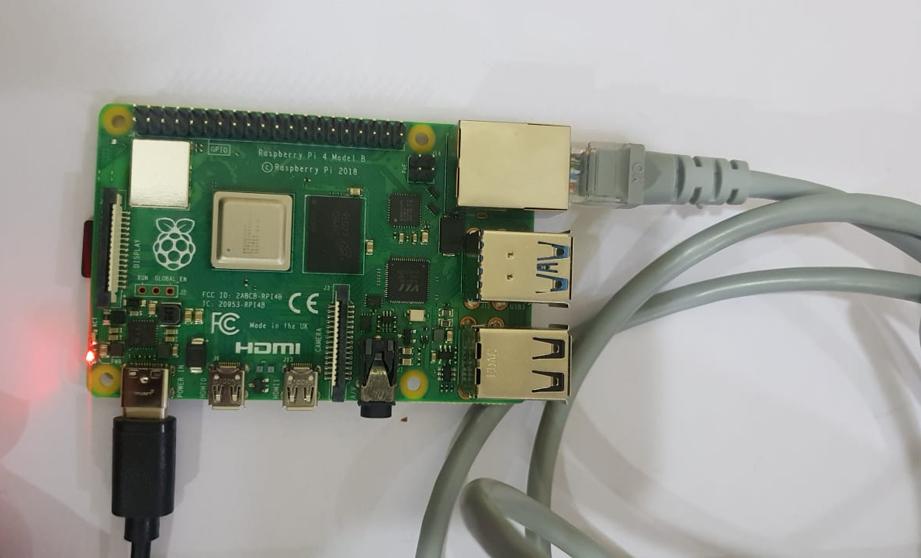
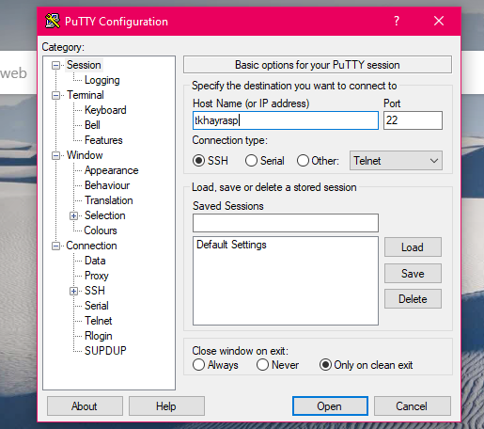
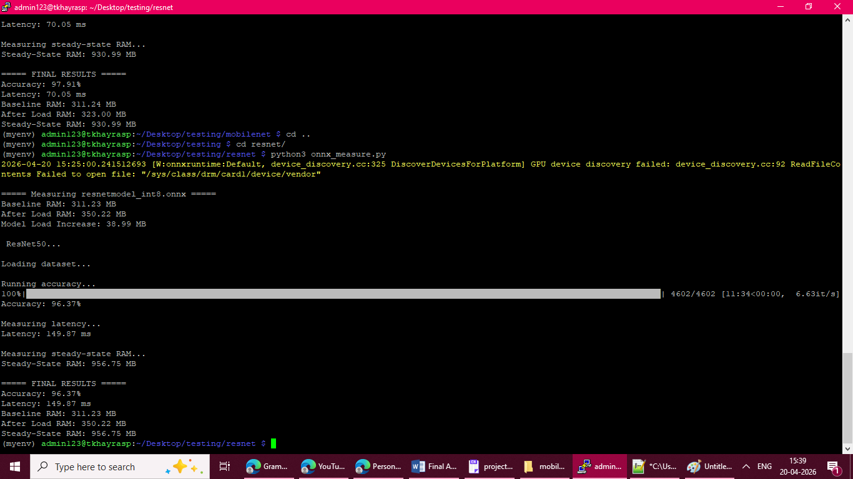
Raspberry Pi Access
Ethernet setup with DHCP (192.168.1.1)
Remote Access:
SSH using hostname: tkhayrasp
CLI used for:
Running scripts & Monitoring performance

Slide 8
Raspberry Pi Access
Virtual Environment created
Relevant ONNX libraries installed
3 Different Models loaded in
Resnet50, MobileNetv2 and Custom Model 2

Slide 9
Deployment + Challenges
Lack of detail in paper:
Quantization method not specified
Deployment setup unclear
Measurement methodology ambiguous
Latency? Memory Usage?
ONNX Conversion Issues:
Possible inefficiencies in runtime
Model behavior changes after conversion
Hardware Differences:
Paper: GPU + 4GB RAM
Raspberry Pi (2GB RAM)
Latency & Memory Discrepancy: Hard to compare batch vs real-time inference

Slide 10
Training Results
Model Architectures Implemented in Pytorch
Training done on Colab using Free Tier GPU
Custom Model 3 was trained in Kaggle
Batch Sizes, Epochs, Optimizers – Set according to paper
Except for Custom Model 2 (Learning Rate Scheduler was used)
Model Name | Training Accuracy
ResNet50 | 94.99%
MobileNetV2 | 96.08%
Custom Model 1 (4 layers) | 89.57%
Custom Model 2 (5 layers) | 97.60%
Custom Model 3 (8 layers) | 98.23%

Slide 11
Evaluation Results
After evaluation on test dataset
Model Name | Test accuracy | Paper’s Test Accuracy
ResNet50 | 94.46% | 83.01%
MobileNetV2 | 96.48% | 30.37%
Custom Model 1 – 4 layers | 94.20% | N/A
Custom Model 2 – 5 layers | 97.30% | 97.70%
Custom Model 3 – 8 layers | 98.26% | N/A

Slide 12
Quantization Results (on Colab)
Quantization was done using Pytorch ( torch.quantization.quantize_dynamic)
ONNX Runtime -> Dynamic Quantization
Quantized Model Name | Test accuracy using Pytorch | Test accuracy using ONNX | Paper’s Test Accuracy
ResNet50 | 97.24% | 21.19% | 82.78%
MobileNetV2 | 98.35% | 97.70% | 30.37%
Custom Model 2 – 5 layers | 97.70% | 97.85% | 97.70%

Slide 13
Deployment Results
Compare that to the 21.19 % accuracy in Colab!
Quantized Model Name | Test accuracy | Paper’s Test Accuracy
ResNet50 | 96.37% | 82.78%
MobileNetV2 | 97.91 % | 30.37%
Custom Model 2 – 5 layers | 71.40% | 95.12%
Significant accuracy drop observed for Custom Model 2 on Raspberry Pi
Possible ONNX Runtime compatibility issues on ARM architecture/Colab
ResNet50 and MobileNetV2 maintained high accuracy
These results exceed paper values
Differ from Colab results
Differences likely due to conversion issues
Dynamic Quantization might not be compatible

Slide 14
Latency Results
Model | Paper Latency (ms) | Implementation (ms)
Custom CNN (Model 2) | 16.75 | 147.92
MobileNet | 141.69 | 70.05
ResNet50 | 784.32 | 149.87
MobileNet performed better in our implementation
Custom Model 2 and ResNet50 showed higher latency than expected
Differences likely due to ONNX Runtime optimization.
Latency induced due to Dynamic Quantization overhead (most likely)

Slide 15
Memory Usage (on Raspberry Pi)
Model | Baseline RAM (MB) | After Load RAM (MB) | Steady-State RAM (MB) | Memory Usage from Paper (GB)
Custom CNN (Model 2) | 311.12 | 317.61 | 966.88 | 0.012 GB
MobileNetv2 | 311.24 | 323.00 | 930.99 | 0.038
ResNet50 | 311.23 | 350.22 | 956.75 | 0.203
All models show high steady-state RAM (~900MB+)
MobileNet is most memory-efficient – Could be because of the model’s architecture itself

Slide 16
Thank you

